Slide 1
Networking

Slide 2


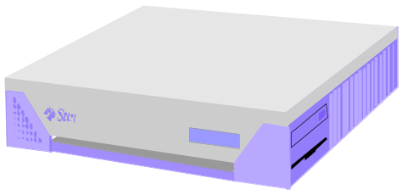
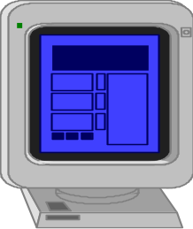
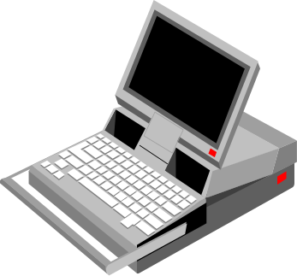
Java networking
Network programming refers to writing programs that execute across multiple devices (computers), in which the devices are all connected to each other using a network.
PC client
Internet Server
Local Area Network
PDA

Slide 3
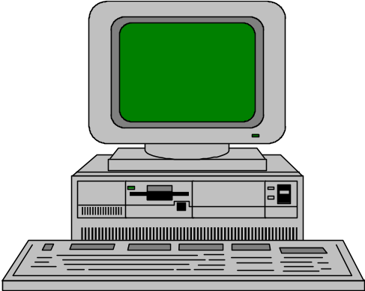

Elements of C-S Computing
a client, a server, and network
Request
Client
Server
Network
Result
Client machine
Server machine

Slide 4
Client/Server
A server is anything that has some resource that can be shared.
  Compute servers, which provide computing power;
  print servers, which manage a collection of printers;
  disk servers, which provide networked disk space;
  web servers, which store web pages.
A client is simply any other entity that wants to gain access to a particular server.

Slide 5
Networking Basics
Applications Layer
  Standard apps
    HTTP
    FTP
    Telnet
  User apps
Transport Layer
  TCP
  UDP
  Programming Interface:
    Sockets
Network Layer
  IP
Data Link Layer
  Device drivers
TCP/IP Stack
Application
(http,ftp,telnet,…)
Transport
(TCP, UDP,..)
Network
(IP,..)
Link
(device driver,..)

Slide 6
Java Networking
The Java platform is very famous in part because of its suitability for writing programs that use and interact with the resources on the Internet and the World Wide Web
Java-compatible browsers use this ability of the Java platform to the extreme to transport and run applets over the Internet

Slide 7
Java Networking
Computers running on the Internet communicate to each other using either the Transmission Control Protocol (TCP) or the User Datagram Protocol (UDP).
When you write Java programs that communicate over the network, you are programming at the application layer.
To decide which Java classes your programs should use, you do need to understand how TCP and UDP differ.

Slide 8
TCP(Transmission Control Protocol)
Internet Protocol (IP) is a low-level routing protocol that breaks data into small packets and sends them to an address across a network, which does not guarantee to deliver said packets to the destination.
TCP allows a reliable communication between two applications and data received in the same order it was sent.
  Otherwise, an error is reported.
TCP provides connection-oriented, reliable, bidirectional, persistent, point-to-point, stream-based connections between hosts on the internet.
  Stream communication
Example applications: HTTP, FTP, Telnet

Slide 9
UDP(User Datagram Protocol)
A connection-less protocol that allows for packets of data to be transmitted between applications.
Rather, it sends independent packets of data, called datagrams, from one application to another.
The order of delivery is not important and is not guaranteed, and each message is independent of any other.
Fast, connection-less, unreliable transport of packets.
  Datagram communication.
Example applications: Clock server, Ping

Slide 10
IP address and Port
Data transmitted over the Internet is accompanied by addressing information that identifies the computer and the port for which it is destined.
The computer is identified by its 32-bit IP address, which IP uses to deliver data to the right computer on the network.
  This address type was specified by IPV4.
  IPV6 uses 128 bit value to represent an address.
    Adv: it supports much larger address space.
    Downward compatible with IPV4.
Ports are identified by a 16-bit number, which TCP and UDP use to deliver the data to the right application on the computer.

Slide 11
Understanding Ports
server
P
o
r
t
TCP
Client
app
app
app
app
port
port
port
port
TCP or UDP
Packet
Data
port#
data

Slide 12
Understanding Ports
Port numbers range from 0 to 65,535 because ports are represented by 16-bit numbers.
Some ports have been reserved to support common/well known services:
    Domain Name System (DNS): 53
    File Transfer Protocol (FTP): 21
    Hypertext Transfer Protocol (HTTP): 80
    Network News Transfer Protocol (NNTP):119
    Post Office Protocol (POP3): 110
    Simple Mail Transfer Protocol (SMTP): 25
    Telnet: 23
    These ports are called well-known ports.
    User level process/services generally use port number value >= 1024.
Your applications should not attempt to bind to them.

Slide 13
Con’t
A server process is said to “listen” to a port until a client is connected to it.
A server is allowed to accept multiple clients connected to the same port number, although each session is unique.
To manage multiple client connections, a server process must be multithreaded.

Slide 14
Socket
Sockets are just like an end-point of two-way communication, which allow applications to communicate using network hardware and operating systems.
  Basically, socket = IP + ports.
A client program creates a socket on its end of the communication and attempts to connect that socket to a server.
When the connection is made, the server creates a socket object on its end of the communication.
The client and server can now communicate by writing to and reading from the socket.
Need to include java.net package.
The java.net.Socket class represents a socket, and the java.net.ServerSocket class provides a mechanism for the server program to listen for clients and establish connections with them.

Slide 15
Proxy Servers
A proxy server speaks the client side of a protocol to another server.
This is often required when clients have certain restrictions on which servers they can connect to.
Thus, a client would connect to a proxy server, which did not have such restrictions, and the proxy server would in turn communicate for the client.

Slide 16
Domain Naming Service (DNS)
Difficult to remember “http://192.9.9.1/”.
DNS is an Internet service that translates domain names into IP addresses.
  www.example.com
The InetAddress class is used to encapsulate both the numerical IP address and the domain name for that address.
InetAddress

Slide 17
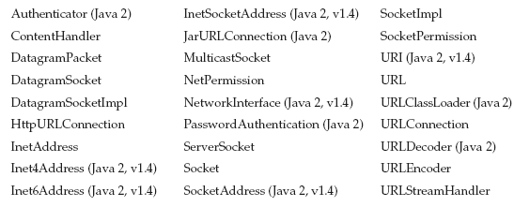

The Networking Classes and Interfaces
------------------------------------------------------------------------------

Slide 18
Factory Methods
The InetAddress class has no visible constructors.
Factory methods are convention whereby static methods in a class return an instance of that class.
  static InetAddress getLocalHost( ) throws UnknownHostException
  static InetAddress getByName(String hostName) throws UnknownHostException
  static InetAddress[ ] getAllByName(String hostName) throws UnknownHostException
Inet.java
InetAddressTest.java

Slide 19
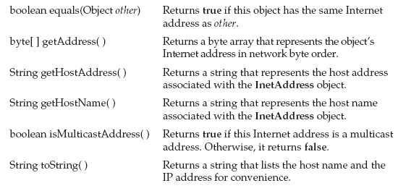
Methods of InetAddress class
Hostname.java
ReadIPAddress.java

Slide 20
Networking Basics
java.net provides the classes for implementing networking applications.
java.net package can be divided in two sections:
A Low Level API, which deals with the following abstractions:
  Addresses, which are networking identifiers, like IP addresses.
  Sockets, which are basic bidirectional data communication mechanisms.
  Interfaces, which describe network interfaces.
A High Level API, which deals with the following abstractions:
  URIs, which represent Universal Resource Identifiers.
  URLs, which represent Universal Resource Locators.
  Connections, which represents connections to the resource pointed to by URLs.

Slide 21
Sockets
TCP: Socket, and ServerSocket classes
  Socket – for implementing a client
  ServerSocket – for implementing a server
UDP: DatagramPacket, DatagramSocket, and MulticastSocket classes.
Socket(String hostName, int port)
  Creates a socket connecting the local host to the named host and port; can throw an UnknownHostException or an IOException.
Socket(InetAddress ipAddress, int port)
  Creates a socket using a preexisting InetAddress object and a port; can throw an IOException.
TCP/IP Client Sockets

Slide 22
Methods of Sockets class
InetAddress getInetAddress( )
  Returns the InetAddress associated with the Socket object.
int getPort( )
  Returns the remote port to which this Socket object is connected.
int getLocalPort( )
  Returns the local port to which this Socket object is connected.
Once the Socket object has been created, it gain access to the input and output streams associated with it.
Each of these methods can throw an IOException.
  InputStream getInputStream( )
    Returns the InputStream associated with the invoking socket.
  OutputStream getOutputStream( )
    Returns the OutputStream associated with the invoking socket.

Slide 23
High level API
URL is the class representing a Universal Resource Locator
  – URLConnection is created from a URL and is the communication link used to access the resource pointed by the URL
    This abstract class will delegate most of the work to the underlying protocol handlers like http or ftp.
  – HttpURLConnection is a subclass of URLConnection and provides some additional functionalities specific to the HTTP protocol

Slide 24
URL(Uniform Resource Locator)
Uniquely identify information on the Internet.
URLs are ubiquitous; every browser uses them to identify information on the Web.
Format
http://www.example.com:80/index.htm
  http : protocol
  www.example.com : host name or IP address
  80 : port address
  Index.htm : resource (filename)
URL class has several constructors, and each can throw a MalformedURLException.

Slide 25
Con’t
URL(String urlSpecifier)
URL(String protocolName, String hostName, int port, String path)
URL(String protocolName, String hostName, String path)
URL(URL urlObj, String urlSpecifier)

Slide 26
URL, URN and URI
URLs always start with a protocol (http) and usually contain information such as the network host name (example.com) and often a document path (/foo/mypage.html).
URLs may have query parameters and fragment identifiers.
URN identifies a resource by a unique and persistent name.
  URNs can identify ideas and concepts. They are not restricted to identifying documents.
  When a URN does represent a document, it can be translated into a URL by a "resolver".
  The document can then be downloaded from the URL.

Slide 27
Cont…
A Uniform Resource Identifier (URI) is a compact sequence of characters that identifies an abstract or physical resource.
A URI can be further classified as a locator, a name, or both.
  The term “Uniform Resource Locator” (URL) refers to the subset of URIs that, in addition to identifying a resource, provide a means of locating the resource by describing its primary access mechanism.
  (e.g., its network “location”).

Slide 28
Cont…
First of all (as we see in the diagram as well) a URL is a type of URI.
But that doesn’t mean all URIs are URLs. All butterflies fly, but not everything that flies is a butterfly.
The part that makes a URI a URL is the inclusion of the “access mechanism”, or “network location”, e.g. http:// or ftp://.
The URN is the “globally unique” part of the identification; it’s a unique name.

Slide 29
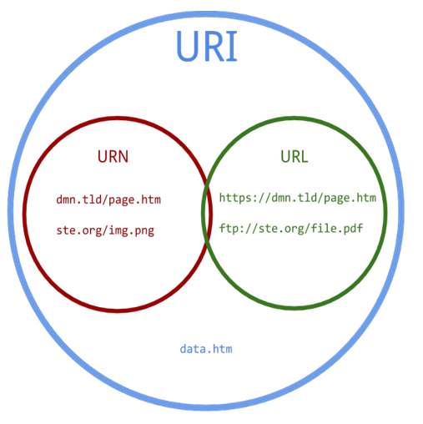
Cont..
One can classify URIs as locators (URLs), or as names (URNs), or as both.
A Uniform Resource Name (URN) functions like a person’s name, while a Uniform Resource Locator (URL) resembles that person’s street address.
In other words: the URN defines an item’s identity, while the URL provides a method for finding it.
URLDemo.java
urlTOuri.java

Slide 30
URLConnection
URLConnection is a general-purpose class for accessing the attributes of a remote resource.
URLConnection to inspect the properties of the remote object before actually transporting it locally.
URLReadFile.java

Slide 31
TCP/IP Server Sockets
The ServerSocket class is used to create servers that listen for either local or remote client programs to connect to them on published ports.
When you create a ServerSocket, it will register itself with the system as having an interest in client connections.
The constructors for ServerSocket reflect the port number that you wish to accept connections on and, optionally, how long you want the queue for said port to be.
The queue length tells the system how many client connections it can leave pending before it should simply refuse connections.
The default is 50.

Slide 32
Con’t
ServerSocket(int port)
  Creates server socket on the specified port with a queue length of 50.
ServerSocket(int port, int maxQueue)
  Creates a server socket on the specified port with a maximum queue length of maxQueue.
ServerSocket(int port, int maxQueue, InetAddress localAddress)
  Creates a server socket on the specified port with a maximum queue length of maxQueue. On a multihomed host, localAddress specifies the IP address to which this socket binds.

Slide 33
Methods of ServerSocket class
public Socket accept() throws IOException
Waits for an incoming client. This method blocks until either a client connects to the server on the specified port or the socket times out. Otherwise, this method blocks indefinitely.
public int getLocalPort() returns the port that the server socket is listening on.

Slide 34
Steps occurs when establishing a TCP connection between two computers using sockets
The server instantiates a ServerSocket object, denoting which port number communication is to occur on.
The server invokes the accept() method of the ServerSocket class. This method waits until a client connects to the server on the given port.
After the server is waiting, a client instantiates a Socket object, specifying the server name and port number to connect to.

Slide 35
Steps occurs when establishing a TCP connection between two computers using sockets
The constructor of the Socket class attempts to connect the client to the specified server and port number.
If communication is established, the client now has a Socket object capable of communicating with the server.
On the server side, the accept() method returns a reference to a new socket on the server that is connected to the client's socket.

Slide 36
UDP(Datagram Communication)
Datagrams are bundles of information passed between machines.
UDP protocol implements datagrams using two classes:
  DatagramPacket object is the data container.
  DatagramSocket is the mechanism used to send or receive the DatagramPackets.
Constructors:
  DatagramPacket(byte data[ ], int size)
  DatagramPacket(byte data[ ], int offset, int size)
  DatagramPacket(byte data[ ], int size, InetAddress ipAddress, int port)
  DatagramPacket(byte data[ ], int offset, int size, InetAddress ipAddress, int port)

Slide 37
Con’t
Socket
  Server.java
  Client.java
  MTS.java
  Client1.java
Message
  Server.java
  Client.java

Slide 38
DatagramPacket methods
InetAddress getAddress( )
  Returns the destination InetAddress, typically used for sending.
int getPort( )
  Returns the port number.
byte[ ] getData( )
  Returns the byte array of data contained in the datagram. Mostly used to retrieve data from the datagram after it has been received.
int getLength( )
  Returns the length of the valid data contained in the byte array that would be returned from the getData( ) method. This typically does not equal the length of the whole byte array.

Slide 39
Datagram Server and Client
Datagram
  DatagramServer.java
  DatagramClient.java
  UDPServer.java
  UDPClient.java
Multicast
  MulticastServer.java
  MulticastClient.java

Slide 40

What is IP Multicasting?
IP multi-casting is a communication mechanism in which data is communicated from server to a set of clients who are interested in receiving that data.
  Any client can dynamically enter or leave the communication.
To understand how multi-casting works, one needs to understand the structure of multicast IP address.
In terms of classes, it’s the Class D IP addresses that are used as multicast IP addresses.
Below is the structure of Class D IP addresses.
So, it can be easily said that multicast IPs range from 224.0.0.0 to 239.255.255.255.
As with the case of ports (where we have well known ports i.e. 0-1024), there are some reserved multicast IP addresses or well known IP addresses.

Slide 41
What is IP Multicasting?
In case of multicast communication, the server sends data on a particular multicast IP address and clients who intend to receive that data need to listen on the same multicast address.
These clients can be various different networks.
A group of clients listening to same multicast address is known as host group.

